Slide 1
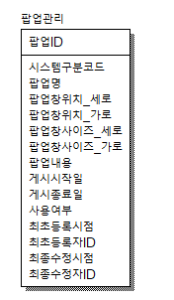
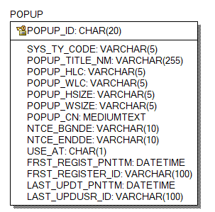

CREATE TABLE POPUP
(
POPUP_ID CHAR(20) NOT NULL,
SYS_TY_CODE VARCHAR(5) NULL,
POPUP_TITLE_NM VARCHAR(255) NULL,
POPUP_HLC VARCHAR(5) NULL,
POPUP_WLC VARCHAR(5) NULL,
POPUP_HSIZE VARCHAR(5) NULL,
POPUP_WSIZE VARCHAR(5) NULL,
POPUP_CN MEDIUMTEXT NULL,
NTCE_BGNDE VARCHAR(10) NULL,
NTCE_ENDDE VARCHAR(10) NULL,
USE_AT CHAR(1) NULL,
FRST_REGIST_PNTTM DATETIME NULL,
FRST_REGISTER_ID VARCHAR(100) NULL,
LAST_UPDT_PNTTM DATETIME NULL,
LAST_UPDUSR_ID VARCHAR(100) NULL
);
ALTER TABLE POPUP
ADD PRIMARY KEY (POPUP_ID);
ALTER TABLE POPUP COMMENT = '팝업관리';

Slide 2
ALTER TABLE POPUP CHANGE COLUMN POPUP_ID POPUP_ID CHAR(20) NOT NULL COMMENT '팝업ID’;
(이하 앞에 내용 전체동일 ALTER TABLE RESVEREQSTINFOTEMP CHANGE COLUMN ~~~)
SYS_TY_CODE SYS_TY_CODE VARCHAR(5) NULL COMMENT '시스템구분코드’;
POPUP_TITLE_NM POPUP_TITLE_NM VARCHAR(255) NULL COMMENT '팝업명’;
POPUP_HLC POPUP_HLC VARCHAR(5) NULL COMMENT '팝업창위치_세로’;
POPUP_WLC POPUP_WLC VARCHAR(5) NULL COMMENT '팝업창위치_가로’;
POPUP_HSIZE POPUP_HSIZE VARCHAR(5) NULL COMMENT '팝업창사이즈_세로’;
POPUP_WSIZE POPUP_WSIZE VARCHAR(5) NULL COMMENT '팝업창사이즈_가로’;
POPUP_CN POPUP_CN MEDIUMTEXT NULL COMMENT '팝업내용’;
NTCE_BGNDE NTCE_BGNDE VARCHAR(10) NULL COMMENT '게시시작일’;
NTCE_ENDDE NTCE_ENDDE VARCHAR(10) NULL COMMENT '게시종료일’;
USE_AT USE_AT CHAR(1) NULL COMMENT '사용여부’;
FRST_REGIST_PNTTM FRST_REGIST_PNTTM DATETIME NULL COMMENT '최초등록시점’;
FRST_REGISTER_ID FRST_REGISTER_ID VARCHAR(100) NULL COMMENT '최초등록자ID’;
LAST_UPDT_PNTTM LAST_UPDT_PNTTM DATETIME NULL COMMENT '최종수정시점’;
LAST_UPDUSR_ID LAST_UPDUSR_ID VARCHAR(100) NULL COMMENT '최종수정자ID';

Slide 3
ID젠 추가
<!-- 팝업 START-->
<bean name="popupIdGnrService"
class="egovframework.rte.fdl.idgnr.impl.EgovTableIdGnrServiceImpl"
destroy-method="destroy">
<property name="dataSource" ref="egov.dataSource" />
<property name="strategy" ref="popupStrategy" />
<property name="blockSize" value="10"/>
<property name="table" value="IDS"/>
<property name="tableName" value="POPUP_ID"/>
</bean>
<bean name="popupStrategy"
class="egovframework.rte.fdl.idgnr.impl.strategy.EgovIdGnrStrategyImpl">
<property name="prefix" value="POPUP_" />
<property name="cipers" value="14" />
<property name="fillChar" value="0" />
</bean>
<!-- 팝업 END-->
INSERT INTO ids(
TABLE_NAME
,NEXT_ID
) VALUES (
'POPUP_ID'
,1
)

Slide 4
쿠키스크립트 파일, x이미지파일 추가
<script src="/asset/cookie.js"></script>

Slide 5
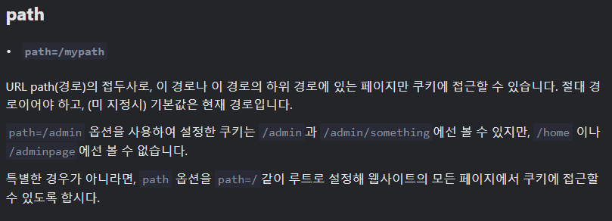
https://ko.javascript.info/cookie

Slide 6
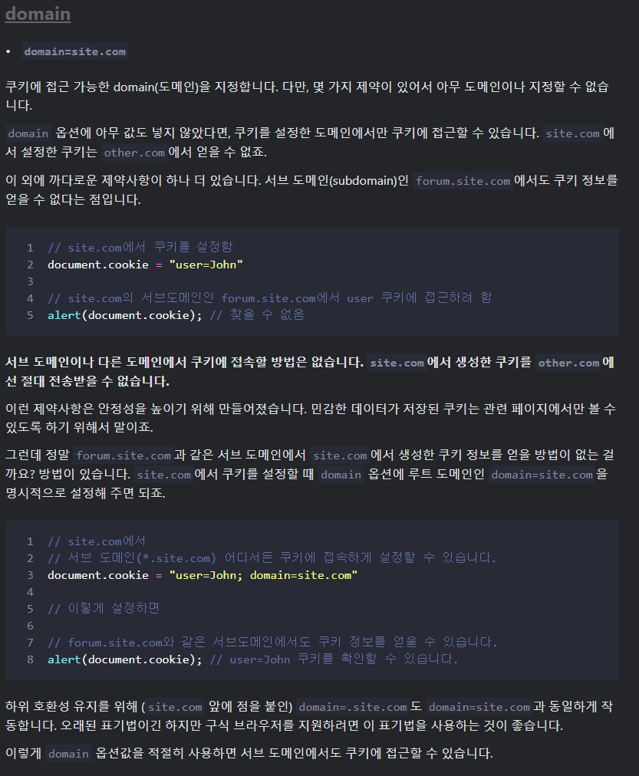

Slide 7
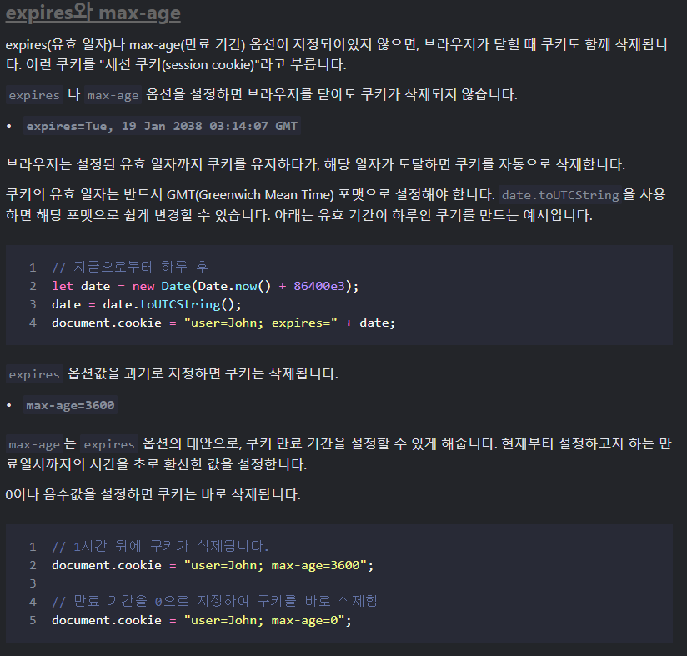

Slide 8
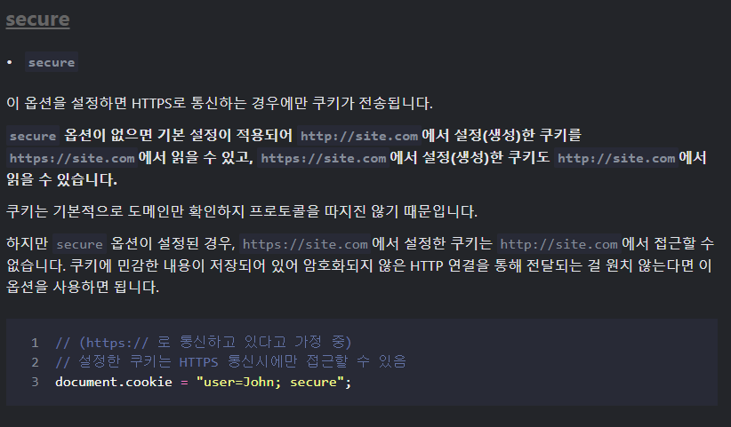

Slide 9
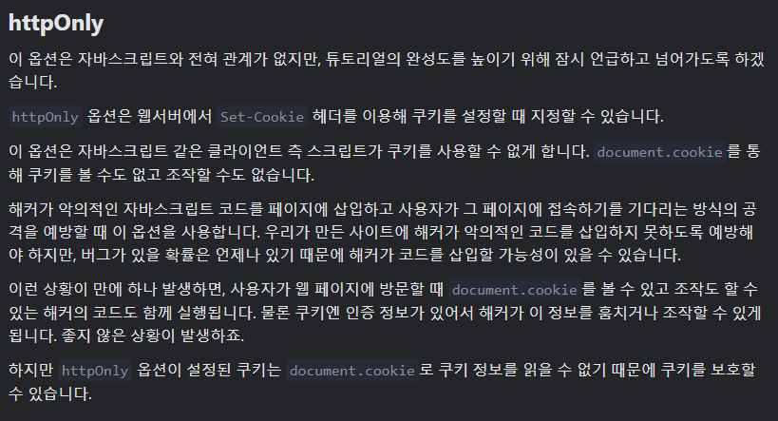

Slide 10
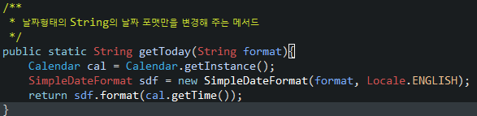
EgovDateUtil에 해당 메소드 추가

Slide 11
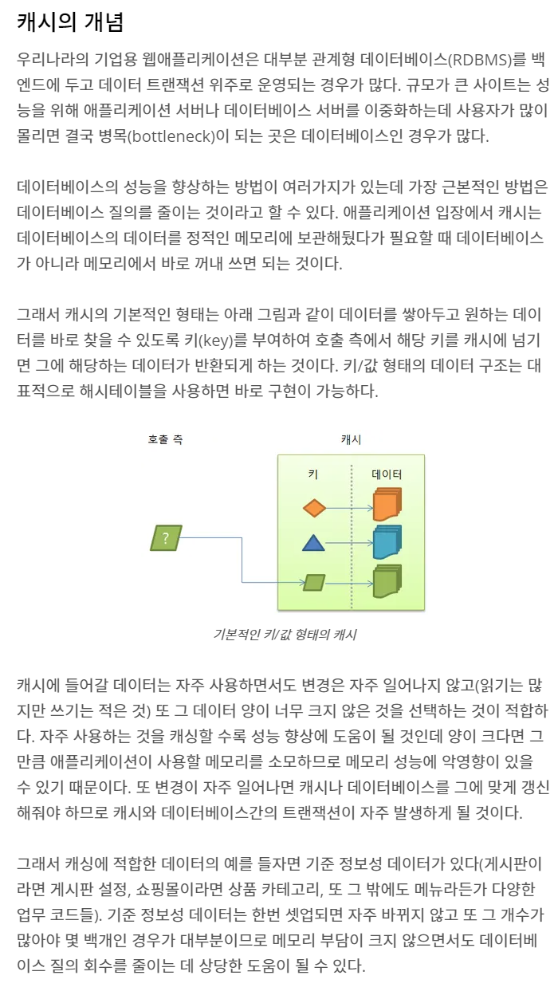

Slide 12
메인페이지에 팝업호출 import 생성
<c:import url="/popup/popupService.do" charEncoding="utf-8"/>

